Slide 1

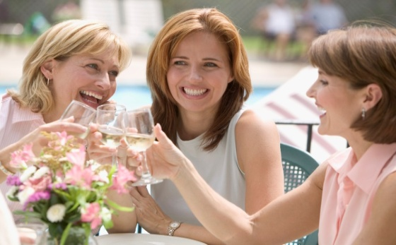
Hello,
May we introduce ourselves we are the Women’s Section of the Royal British Legion.
Why we exist?
The Women’s Section of the Royal British Legion have provide welfare support to War Widows and the ex-service & serving families & children for the past 100 years.
What do we do
Throughout the whole 100 years of our existence we have been able to provide much needed assistance to our service and ex-service families in their time of need. The list of support that we have been able to provide is enormous but in recent times assistance has been given as War Widows payments, grants to assist with education & further education, grants to assist with food, warm clothing, shoes, beds & bedding, turbo chairs and adaptations to assist with disabilities.
Do you have a few hours to spare, would you like to join an enthusiastic organisation raising much needed funds for our service families.
Why not come and join as at our meetings where we have quizzes, craft talks, presentations, outings but most importantly lots of FUN.
We Meet On:
At:
Time:
Contact:

