Slide 1

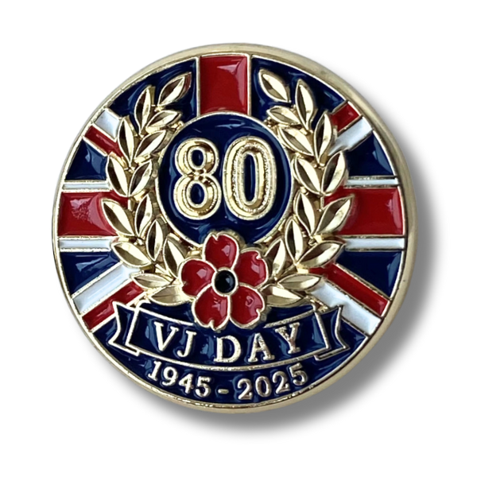
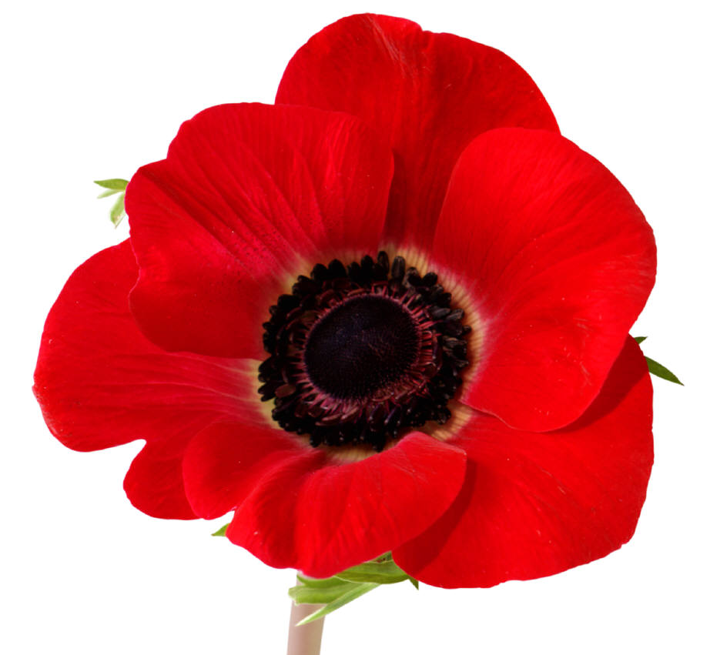

VJ Day 80th
15th August will mark 80 years since the surrender of the Japanese imperial forces, effectively ending the Second World War.
Yeovil & District Branch #2555
Face Book YEOVIL And District RBL Group
On Friday 15th August the Yeovil & District RBL Branch will be holding a short Service of Reflection at the Yeovil War Memorial from 11.45 till 12.15 during which the 12 Noon National 2 minutes Silence will be observed followed by the laying of a Poppy Wreath

